Slide 1

TECHNICAL SEMINAR ON Environmental Impact Of Nanotechnology
Presented By, Under the guidance of,
MAHANTESH BALAGOND
USN:1EP18CS050 Prof. JAGADEVI BAKKA
SEM:8th Semester Department of CSE,EPCET
SEC:’A’ ,
Academic year:2021-2022.

Slide 2
INTRODUCTION
Nanotechnology utilizes the unique properties of nanomaterials which has at least one-dimensional size of a material between 1 nm to 100 nm to produce nanoscale devices, components, and systems.
Applications utilizing nanotechnology includes manufacturing various products, measuring, imaging and manipulating matter on the nanoscale.
Nanoscaled particles have relatively larger surface area per unit mass which is the critical factor to increase mechanical modulus and other physical and chemical properties.
Basic material properties are changed at nanoscale due to the dominance of quantum effects and lesser imperfections.

Slide 3
What is Nanotechnology?
Nano is a prefix used to show one-billionth of a particular parameter. The prefix is usually applied to the length scale in order to indicate an extremely small magnitude of the length dimension.
A nanometer (nm) is a billionth of a meter (10−9m).
The diameter of individual atoms is smaller than 1 nm, a DNA strand typically measures 2 nm, a virus is roughly 100 nm in diameter and the thickness of a sheet of paper is around 100,000 nm

Slide 4
Nanostructures: Environment impact?
Particle-mediated transport
- size
- surface chemistry(hydrophobic)
Potential for bio-assimilation
- direct consequences
- associated contaminants

Slide 5
Nanotechnology and the Environment:
“ A tool for sustainable development rather than an environmental liability”
Enabling technologies to meet many needs
1.water, wastewater
2.hazardous waste
3.resource recovery
4.pollution prevention
Environment consequences of new technologies
1.focus on transport, transformation, and fate of nanostructures
2.proactive approach early in the process

Slide 6
Importance of Nanotechnology in Environment
Agriculture
Agriculture is the use of biological processes to produce food and many other desired products that are beneficial and essential to man by breeding of crops and animals
Water purification
The availability of clean, safe water is fundamental to the sustenance of life and it is important to health, environment, and economy.
Health Care
The application of nanotechnology in health care is known as nanomedicine. Applications of nanotechnology in medicine include prevention, diagnosis, treatment, follow-ups of diseases, drug delivery, therapy and disinfection.

Slide 7
Transport
Transportation involves the conveyance of people, goods and other things over macroscale distances.
The role of transportation in economic development cannot be overemphasized.
Environmental Biomediation
Several daily human activities, industrial processes, and agriculture inherently release chemicals and harmful substances into the environment.
Electronics
The currently predominant electronic technology for manufacturing chip is known as lithography or etching and is based on Moore’s law which permits enhanced functionality, a higher speed of computations, savings in raw materials, weight, and power consumption through continued miniaturization of electronic devices.
Energy
Nanotechnology is being used and is being considered for increased sustainability of the energy sector. Nanotechnology has the capability to provide cleaner and more efficient supplies and usage of energy.
In the energy sector, nanotechnology plays significant roles in the areas of lighting, heating, renewable energy, energy storage, fuel cells, and hydrogen power generation and storage.

Slide 8
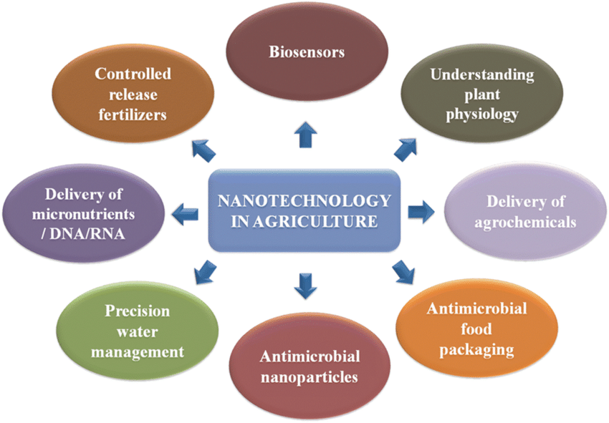
Fig.Imortance of Nanotechnology in Environment

Slide 9
Positive Effects on Environment
Cleaner, more efficient industrial processes.
Improved ability to detect and eliminate pollution by improving air, water, and soil
quality.
High precision manufacturing by reducing amount of waste.
Clean abundant power via more efficient solar cells.
Removal of greenhouse gases and other pollutants from the atmosphere.
Decreased need for large industrial plants.
Remediating environmental damages.

Slide 10
Negative effects on environment :-
High energy requirements for synthesizing nanoparticles causing high energy demand.
Dissemination of toxic, persistent nanosubstances originating environmental harm
Lower recovery and recycling rates
Environmental implications of other life cycle stages also not clear
Lack of trained engineers and workers causing further concerns.

Slide 11
VANET Research Challenges:-

Slide 13
TYPICAL VANET SCENARIO:-

Slide 14
APPLICATIONS OF VANET:-

Slide 15
MAJOR PLAYERS IN VANET RESEARCH:-

Slide 16
CONCLUSION

Slide 17
REFERENCES

Slide 18
THANK YOU

